Slide 1
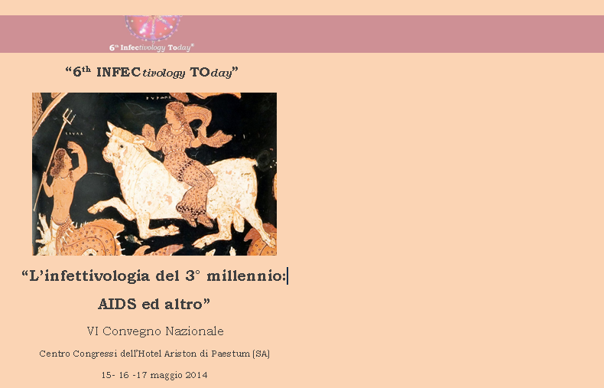
"Gestione e trattamento dell’HCC"
Opzioni chirurgiche:
dalla resezione al trapianto
Prof. Umberto Cillo
M.D, FEBS
Direttore, Chirurgia Epatobiliare
e Centro Trapianto di Fegato
Università- Azienda Ospedaliera
di Padova
cillo@unipd.it
www.fegatochirurgia.com
Notes:
1

Slide 2
……..
...
...
...
….
  …..
  ...

Slide 3
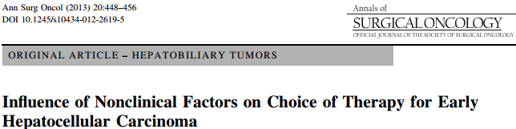
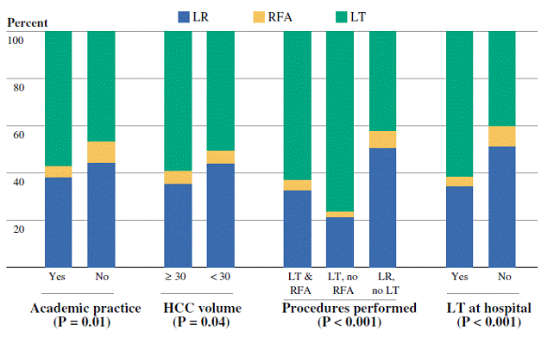
Variation in choice of therapy by nonclinical factors,
after adjustment for clinical factors
Nathan et al, Ann Surg Oncol. 2013 Feb;20(2):448-56
Notes:
3

Slide 4

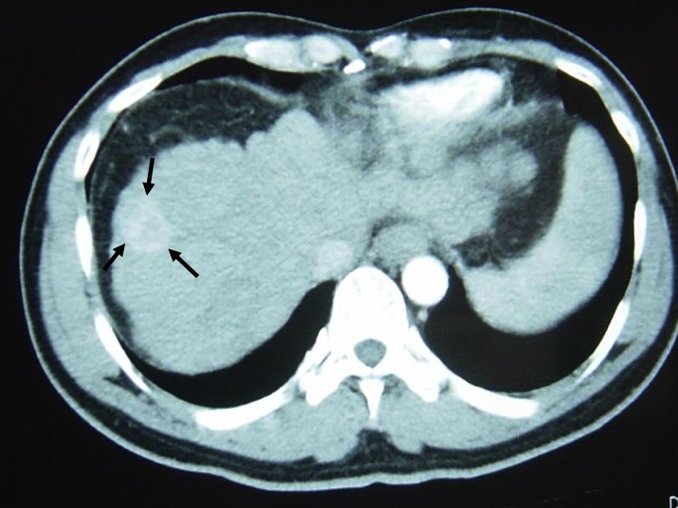
HCC
Resection vs Transplantation
Transplantation
Ablation
Resection
TACE
Sorafenib
Notes:
4

Slide 5
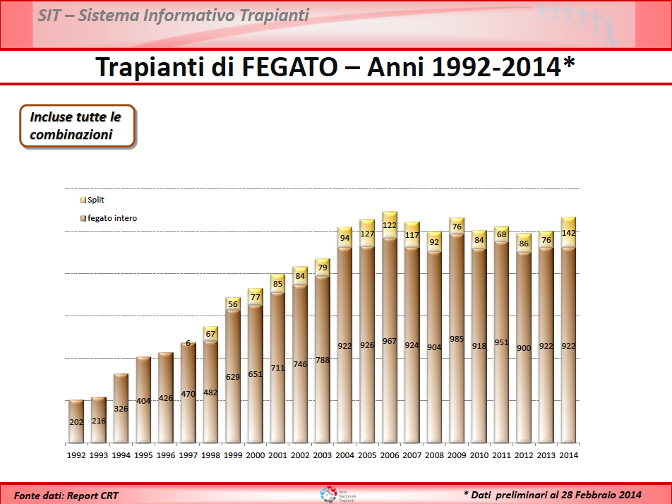
LT in Italy

Slide 6
The central axiom of LT:
disparity demand/resources
Liver related deaths in Italy for 2007
http://www.trapianti.salute.gov.it/cnt/
http://www.istat.it/dati/dataset/20100129_00/
Patient
Organ
Available resources may potantially satisfy
6% of whole demand and 20% of transplantable patients
8447 due to benign chronic liver disease
9725 deaths due to liver cancer
1041 Liver transplants
6% of total deaths
Notes:
6
6

Slide 7
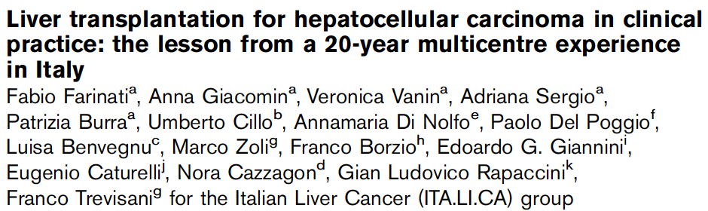
Overall, LT impact on HCC patients’ treatment is very limited
IS LIVER TRANSPLANTATION A VIRTUAL THERAPY?
30% TACE first line: REFERRAL!!
Retrospective analysis of data
of 2042 HCC patients
recruited consecutively and prospectively from January 1987 to December 2006
at 10 clinical institutions
forming the ITA.LI.CA group
- Dati 1987-2006
- Centri TX: 5/9
- Tot tx: 50
- 11% degli elegibili
- Only<65 yrs
Farinati et al, European Journal of Gastroenterology & Hepatology 2012, 24:195–202
Notes:
7

Slide 8

1) ABUSO DI ORGANI IN ITALIA PER HCC?
RESOURCES: Competition between different diseases
 | INCIDENCE | MORTALITY | N° LT | N° LT HCC
USA | 21000 | 18400 | 6000 | 1000
ITALY | 12000 | 10000 | 1000 | 500
USA
N° organs for HCC= 1000
N° of HCC deaths=20000
Ratio = 1: 20
ITALY
N° organs for HCC= 500
N° of HCC deaths=10000
Ratio = 1: 20
P. J. Thuluvath, et al. Am J Transpl 2010; 10: 1003
Angelico M, et al. DLD 2011; 43: 155-164
Notes:
It is important to know the crude numbers of HCC epidemiology to understand the clinical relevance of this cancer. Incidence and mortality are extremely similar and this aspect undelines the poor prognosis of patients with HCC. In USA we have about 20 thousand new cases each year and the estimation in 2020 is of about 27000. In Europe we have 65 thousand new cases each and the estimation in 2020 is 78000 .
In Italy the incidence is high and we have 12000 new cases and 10000 death each year.
8

Slide 9
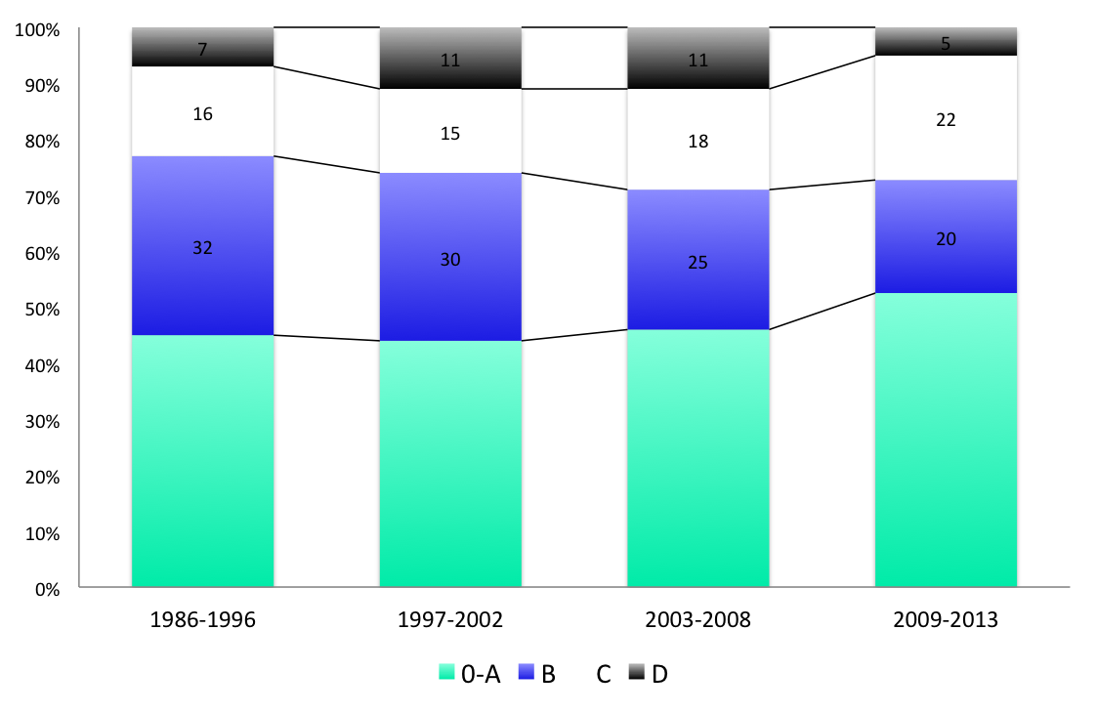
2 ) E’ IL TRAPIANTO DI FEGATO
UNA TERAPIA VIRTUALE ?
DATABASE ITALICA (n=5183): distribuzione degli stadi BCLC in base al periodo

Slide 10
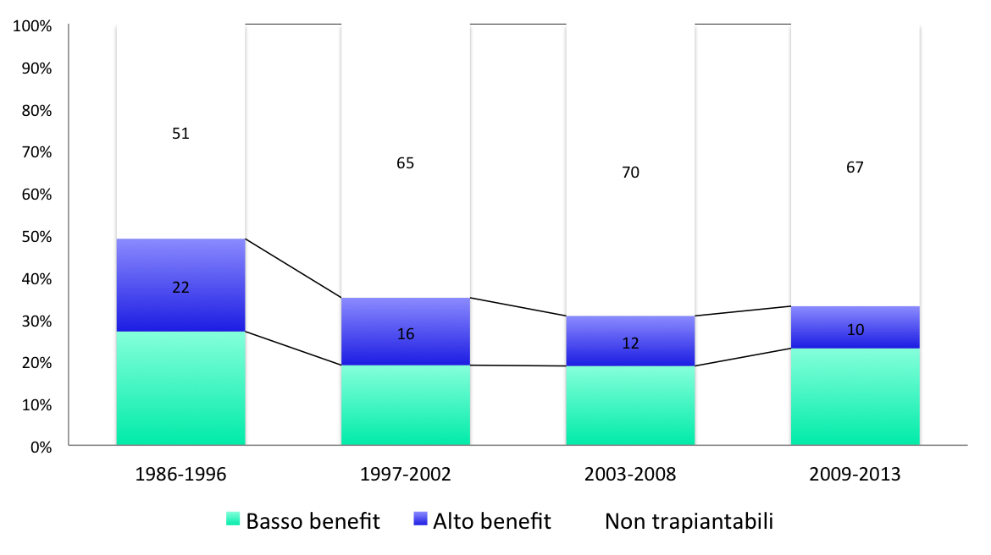
2 ) E’ IL TRAPIANTO DI FEGATO
UNA TERAPIA VIRTUALE ?
DATABASE ITALICA (n=5183): distribuzione della % di trapiantabili in base al periodo
* Non trapiantabili: età > 70 anni, comorbidità rilevanti, invasione macrovascolare o meta
Alto benefit: BCLC B-C o D
Basso benefit: BCLC 0-A
33%
*

Slide 11
2 ) E’ IL TRAPIANTO DI FEGATO
UNA TERAPIA VIRTUALE ?
La potenzialità terapeutica di un procedura (virtuale o meno) va misurata sulla
popolazione target (massimo benefit) e non sulla popolazione generale
12000 nuovi casi HCC /anno in Italia
33% trapiantabili = 3960
1200 alto benefit
2760 basso benefit
500 organi / 1200 = 42%
Terapia virtuale ???
http://www.registri-tumori.it/cms/node/1701

Slide 12
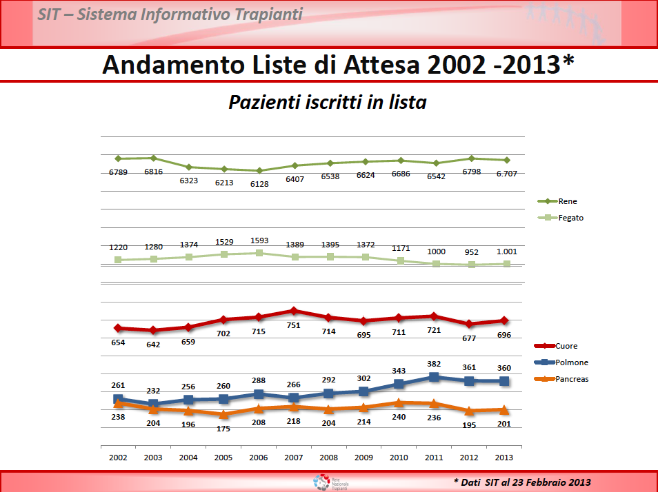
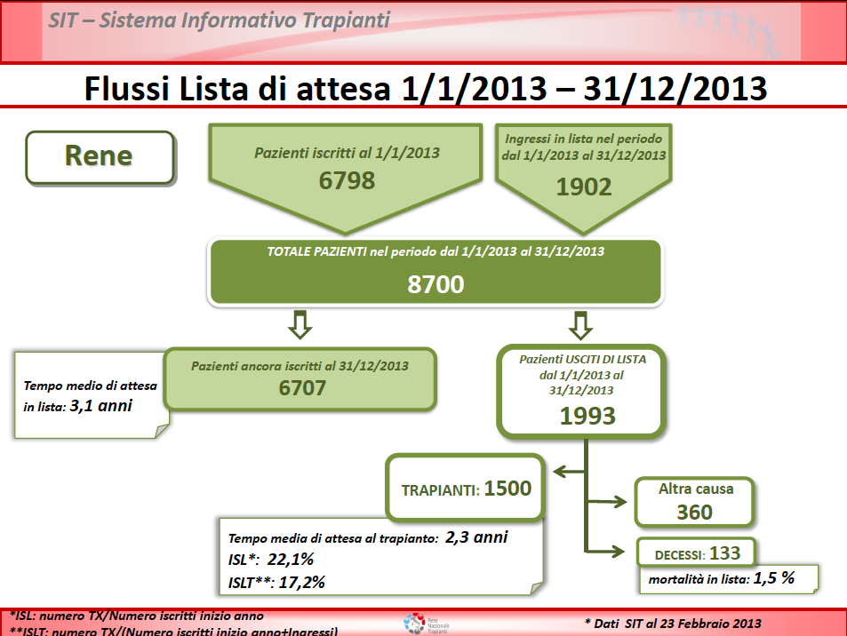
But...
...is Kidney Tx a virtual therapy?
The lack of organs for all patients on the WL
makes the kidney transplant a virtual therapy?
Nordio et al, J Nephrol 2013
In the Veneto region, every year
about 10% of peritoneal dialysis patients
shifted to hemodialysis
and 12% received a transplant
Notes:
12

Slide 13
The Ethical Dimensions of Equipoise in LDLT
LDLT
Cadaveric LT
Recipient
Tx benefit
Recipient
Tx benefit
Donor
harm
Waiting List
benefit/harm
Waiting List
benefit/harm
RECIPIENT TX BENEFIT > (DONOR HARM + WL HARM)
Lee HS. Dig Dis 2007; 25: 296
Miller C. Transpl Rev 2008; 22: 206
Notes:
13
13

Slide 14
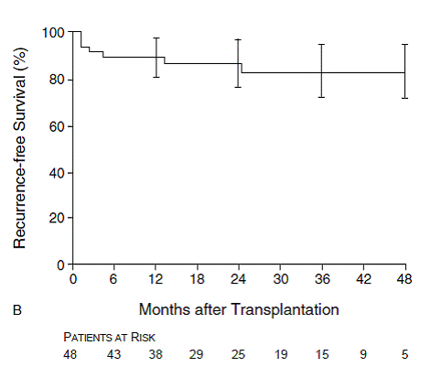
The Milan Criteria paradigm:
UTILITY oriented
Single nodule < 5cm, 2 or 3 nodules < 3cm, no macroscopic vascular invasion, no metastases
?
?
Mazzaferro V, et al. NEJM 1996; 334: 693

Slide 15
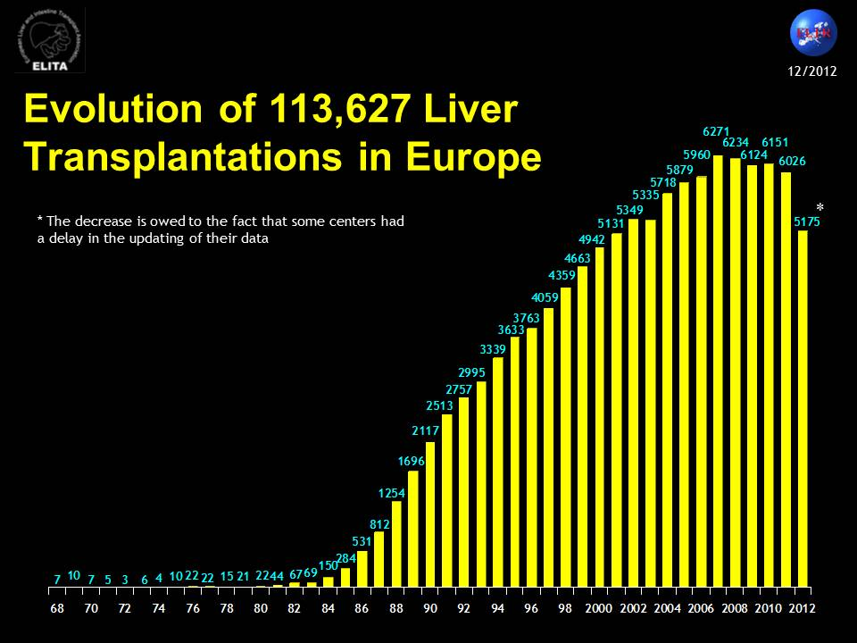
ELTR Data

Slide 16
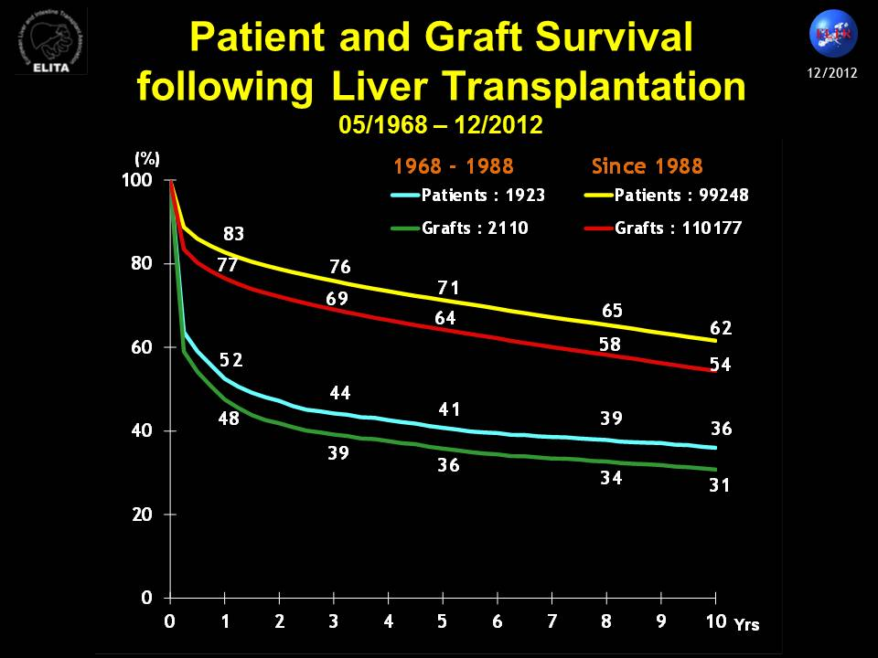
ELTR Data

Slide 17
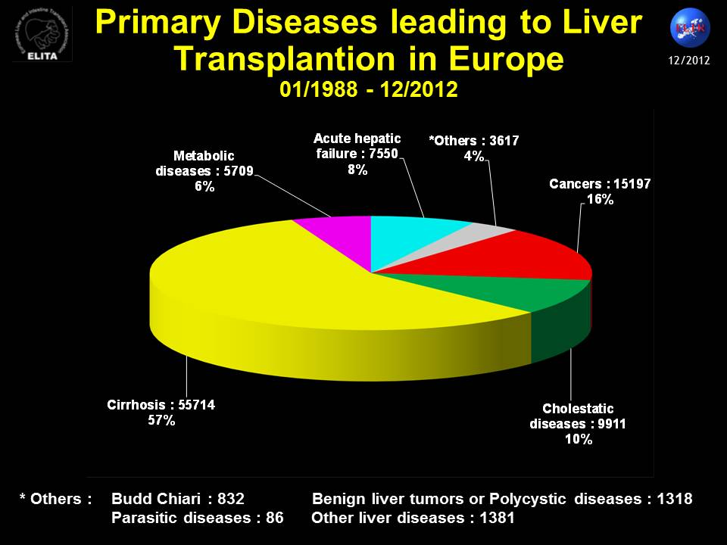
ELTR Data

Slide 18
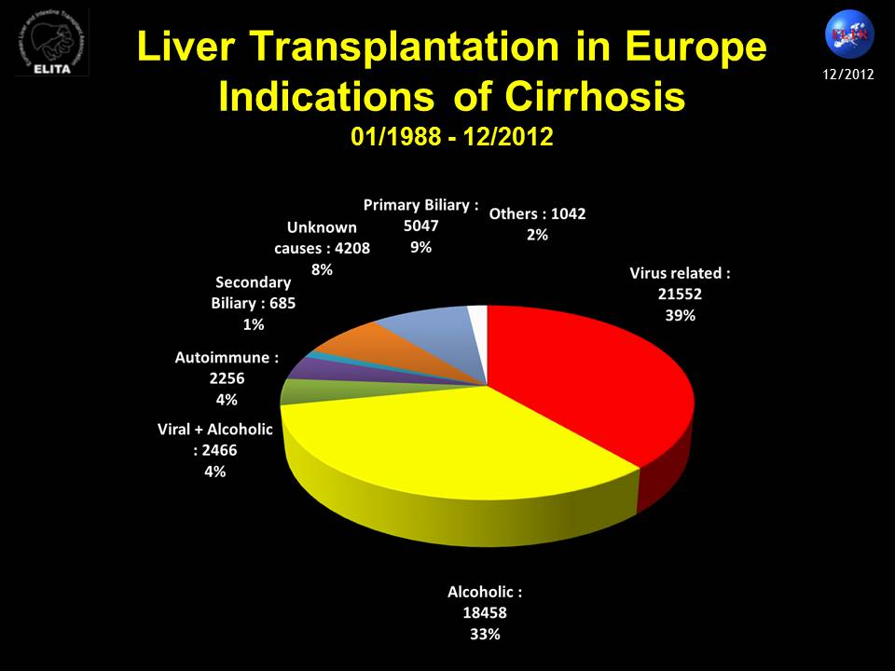
ELTR Data

Slide 19
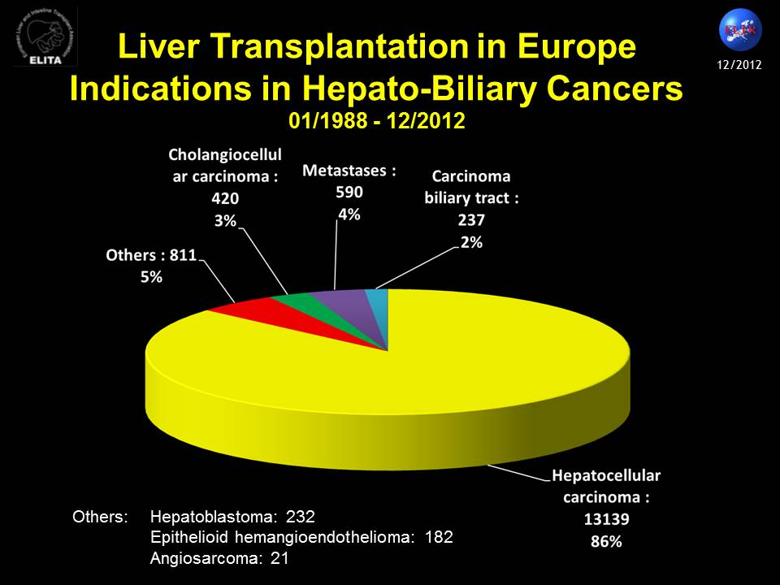
ELTR Data

Slide 20
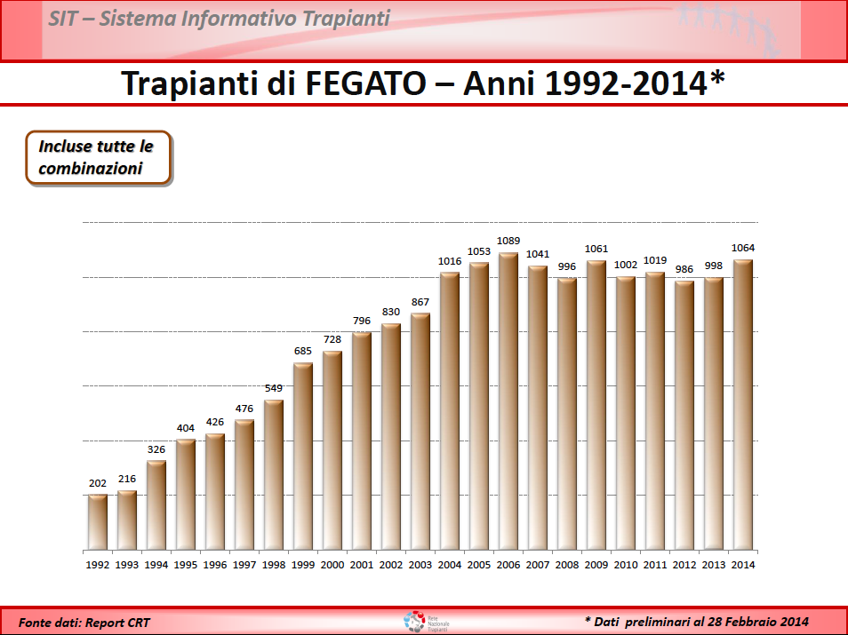
LT in Italy

Slide 21
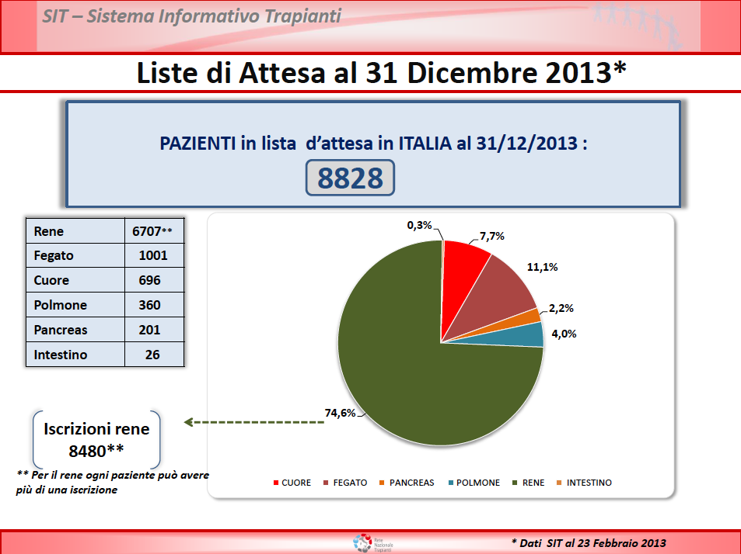
LT in Italy

Slide 22
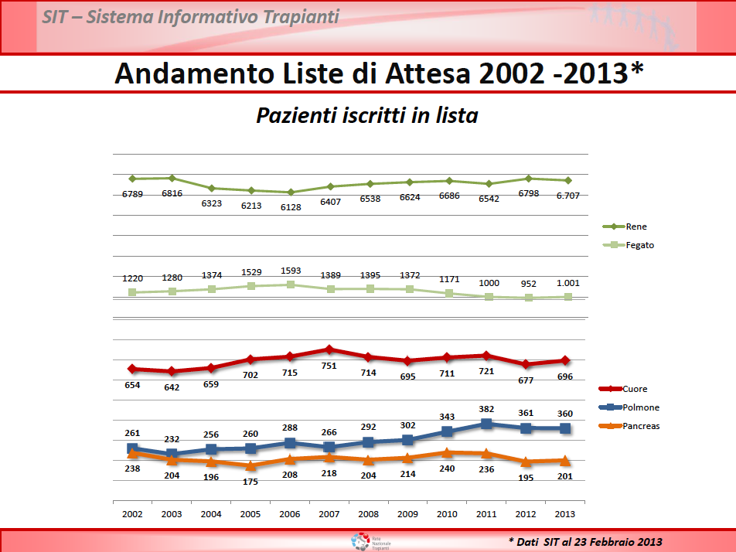
LT in Italy

Slide 23
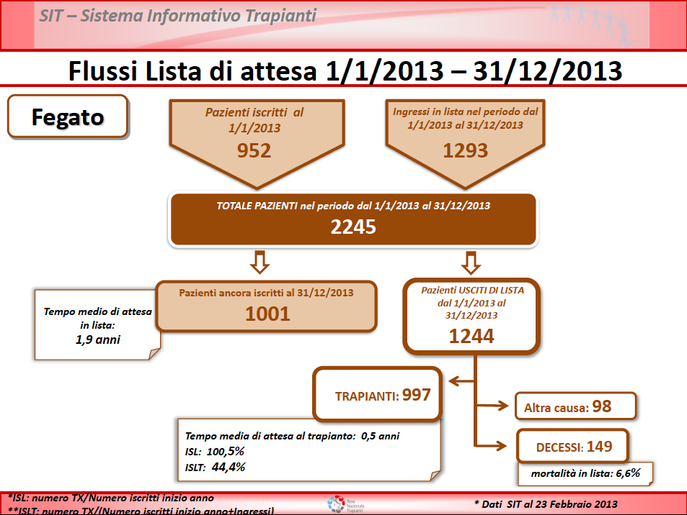
LT in Italy

Slide 24
Overall, LT impact on HCC patients’ treatment is very limited
IS LIVER TRANSPLANTATION A VIRTUAL THERAPY?
30% TACE as first line: REFERRAL!!!
Retrospective analysis
2042 HCC patients
From January 1987 to December 2006
9 clinical institution Forming the ITA.LI.CA group
(5/9 LT centers)
50 LT → 11% of elegible patients
Only < 65 yr
Farinati et al, European Journal of Gastroenterology & Hepatology 2012, 24:195–202
Notes:
24

Slide 25
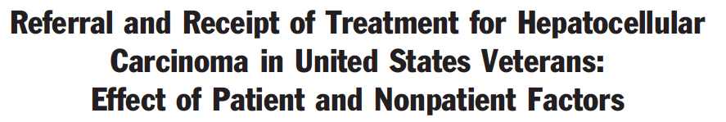
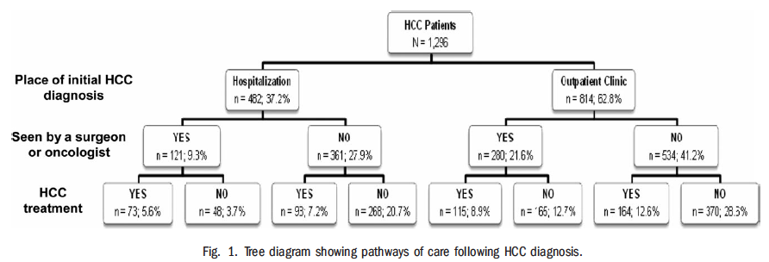
The delivery of treatment for HCC could be influenced by the place of HCC diagnosis, subspecialty referral following diagnosis, as well as physician and facility factors
VA Hepatitis C Clinical Case Registry
1296 HCV-patients who developed
From 1998 to 2006
37.2% during hospitalization
31.0% seen by a surgeon or oncologist,
34.3% received treatment
Being seen by a surgeon or oncologist:
→ associated with surveillance: aOR=1.47
→ predictive of treatment: aOR 5=1.43
Significant increase in treatment among patients:
→ who received surveillance (aOR=1.37)
→ seen by gastroenterology (aOR=1.65)
→ diagnosed at a transplant facility (aOR=1.48)
Approximately 40% of patients were diagnosed during hospitalization
Most patients were not seen by a surgeon or oncologist for treatment evaluation
Only 34% received treatment
Only receipt of HCC surveillance was associated
with increased likelihood of outpatient diagnosis
being seen by a surgeon or oncologist, and treatment
Davila et al, Hepatology 2013;57:1858-1868)
Notes:
25

Slide 26
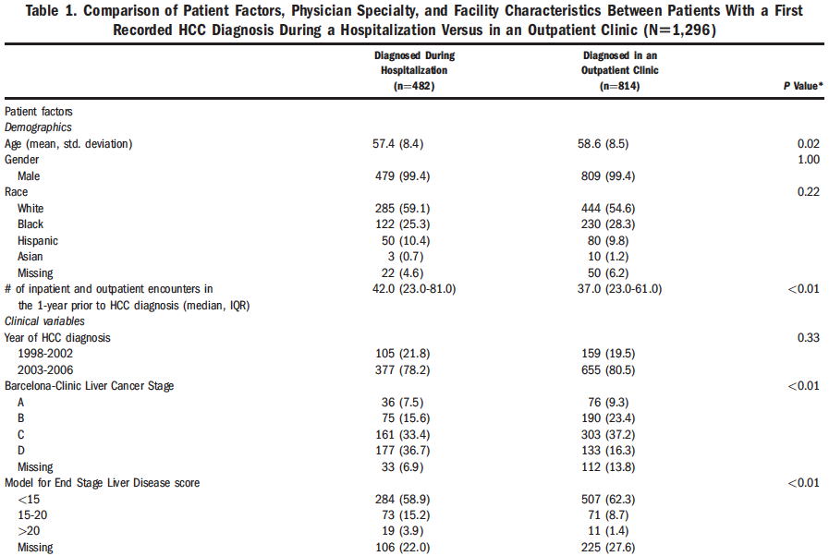
Davila et al, Hepatology 2013;57:1858-1868)
…..
Notes:
26

Slide 27
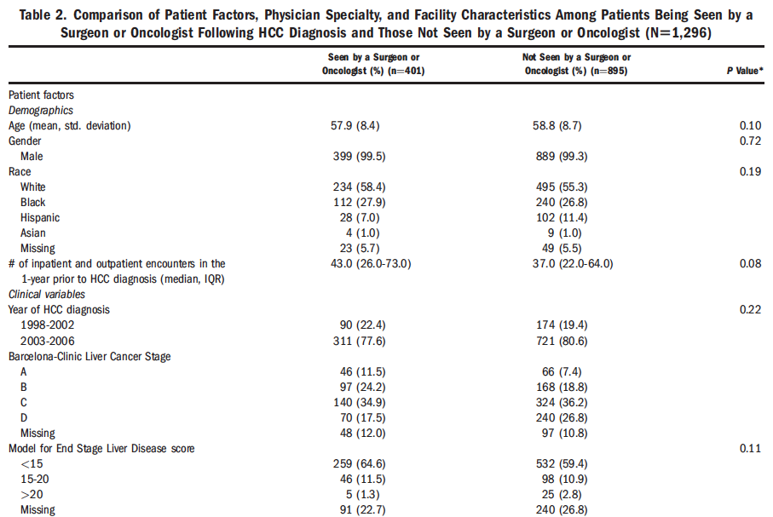
Davila et al, Hepatology 2013;57:1858-1868)
…..
Notes:
27

Slide 28
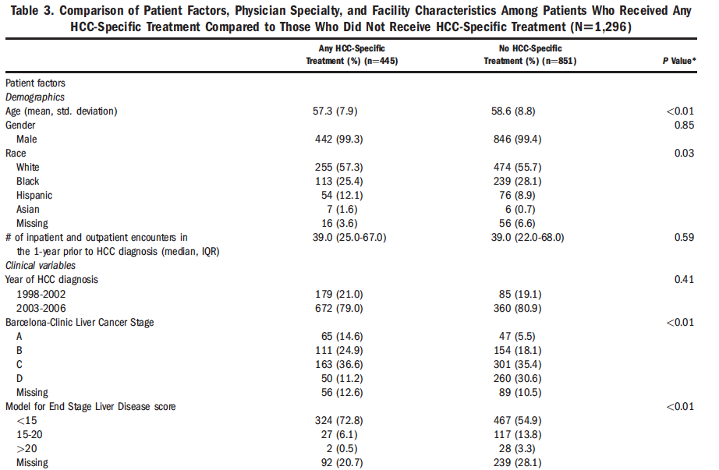
Davila et al, Hepatology 2013;57:1858-1868)
…..
Notes:
28

Slide 29
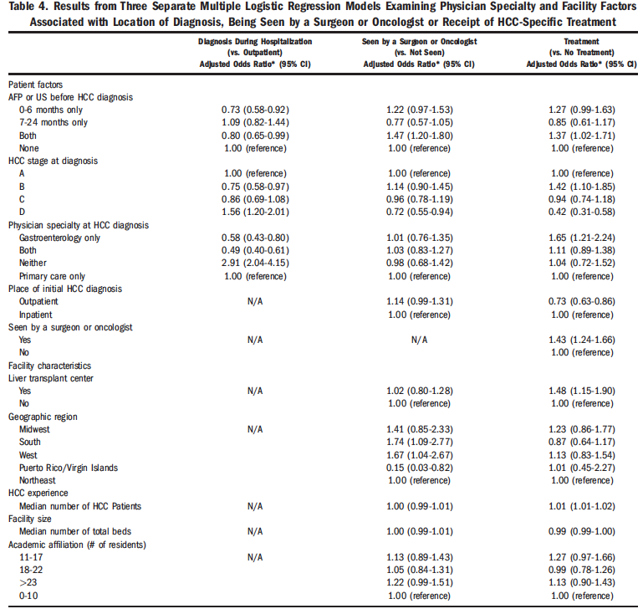
Davila et al, Hepatology 2013;57:1858-1868)
…..
Notes:
29

Slide 30
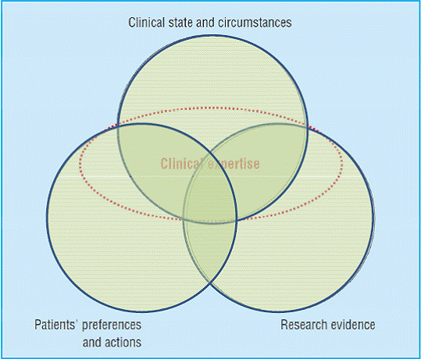
Limits of a specific therapy
An updated model
for EBM
clinical decisions
Haynes RB, et al. BMJ 2002; 324: 1350
Notes:
30

Slide 31
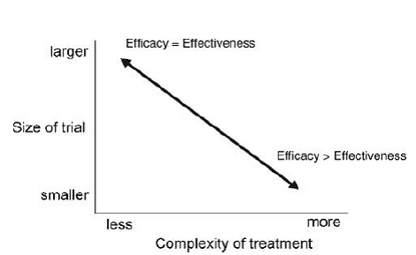
Research evidence &
treatment decision for HCC patients
RCT are not useful to measure the effectiveness
of complex – multifaceted therapies like organ transplantation
Flather M, et al. Clin Trials 2006; 3: 508-512
Notes:
31

Slide 32
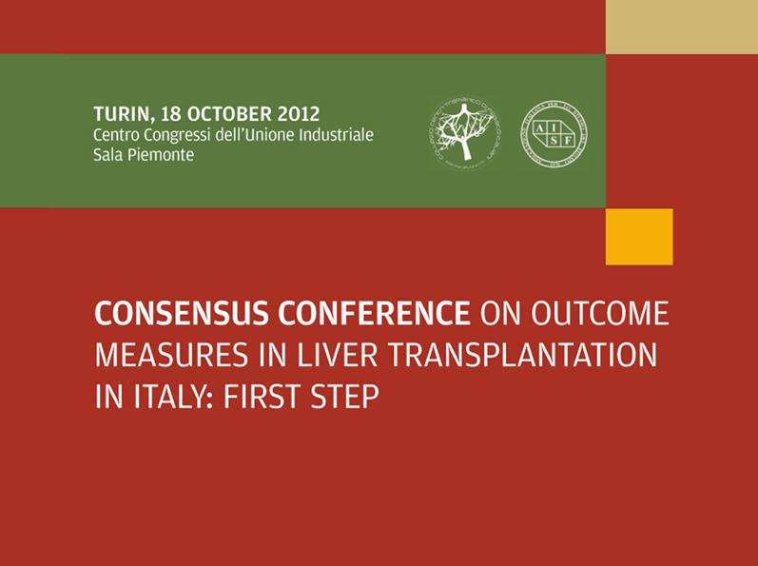

Slide 33

Turin 18 October 2012 AISF-SITO
STATEMENT 1. BEST UTILITY INDICATOR (ENDPOINT)
Five year ITT patient survival has to be preferred to absolute survival for all ESLD patients with or without HCC, since ITT analysis is able to capture the entire therapeutic process that includes liver transplantation (E2 R1)
THE STRICTER THE SELECTION CRITERIA
THE HIGHER THE WAITING LIST DROPOUT
Notes:
33
33
33

Slide 34

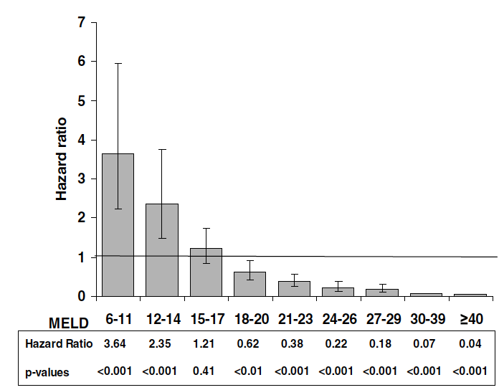
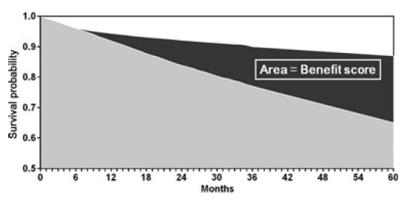
Turin 18 October 2012 AISF-SITO
STATEMENT 7a.
Benefit as indicator (ENDPOINT)
5-year transplant benefit is the best indicator available to maximize the life saving efficiency of procured livers (E2, R2).
UTILITY
BENEFIT
URGENCY
Merion RM, et al. Transpl Int 2011; 25: 965
Merion RM, et al. Am J Transpl Int 2005; 5: 307
Notes:
34
34
34
34

Slide 35
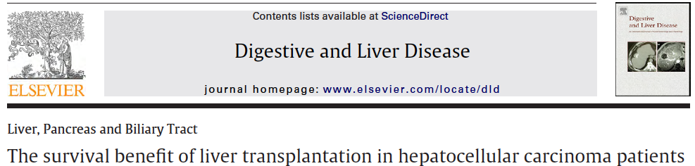
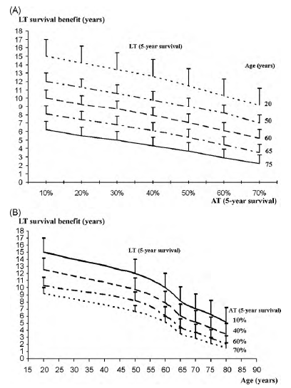
To evaluate survival benefit of LT over alternative therapies in HCC patients
Markov-model
135 aggressively-treated HCC patients
52% Milan-out
At long term analysis:
Survival benefit of LT vs alternative therapies
was 6.115 years
Main determinants of benefit were:
5-year survival prospects after alternative therapies
patient’s age
The survival benefit of liver transplantation for HCC patients
is strongly related to the patient’s age
and the effectiveness of available alternative therapies
Cillo et al, Dig Liv Dis 2010 Sep;42(9):642-9
Notes:
35

Slide 36

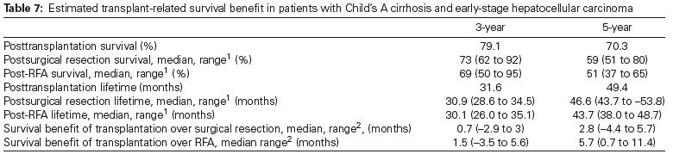
Liver transplantation in patients with stage II HCC and Child A cirrhosis results in a low survival benefit
and may not constitute optimal use of scarce liver donor organs
Ioannou G, et al. American Journal of Transplantation 2012; 12: 706–717
Notes:
36

Slide 37
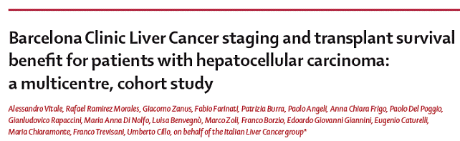
Fast track — Articles
Submitted April 19, 2011
Published Online June 17, 2011
www.thelancet.com/oncology
DOI:10.1016/S1470-2045(11)70144-9
Notes:
37

Slide 38
Monte Carlo simulation
Unadjusted model
Adjusted model
34.6
28.5
24.9
17.4
17.7
13.5
11.2
11.2
Vitale A, et al. Lancet Oncol 2011
Notes:
38
38

Slide 39

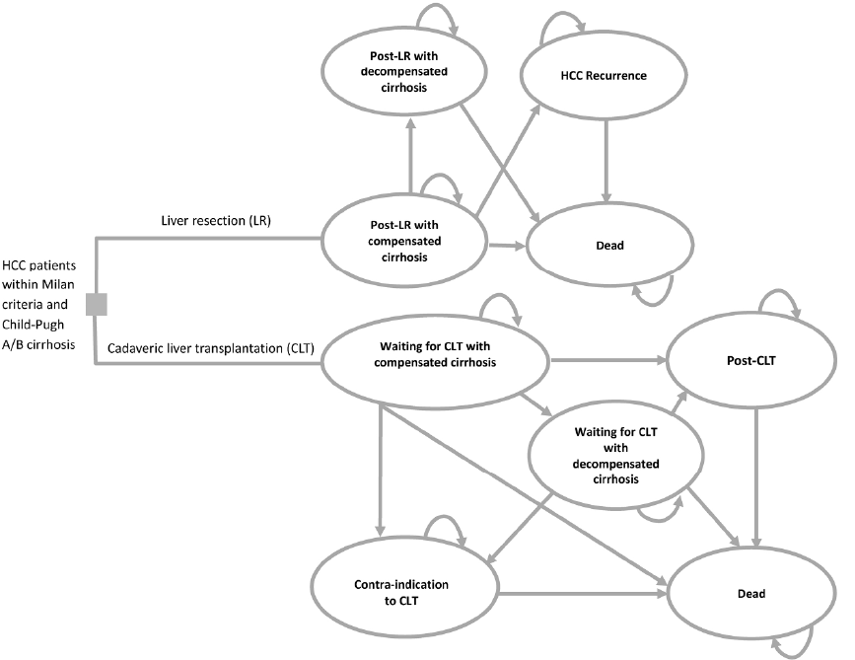
A Markov cohort model
to simulate a cohort of patients aged 55 years with Milan-in HCC and Child-Pugh A/B cirrhosis
undergoing LR or CLT, and followed-up over their remaining life expectancy
IncrementaI Cost-Effectiveness Ratio: Difference in costs
Difference in QUALY
LR → 3.9 QALYs
OLT had an additional 1.4 QALYs
(→ 5,3 QALYs)
Incremental cost-effectiveness ratio (ICER):
- Singapore: $111,821/QALY
- Switzerland: $156,300/QALY
Above thresholds for cost-effectiveness
in all three countries
Lim et al, J Hepatol 2014; In press; doi: 10.1002/hep.27135
Notes:
39

Slide 40
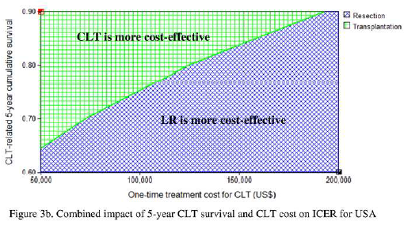
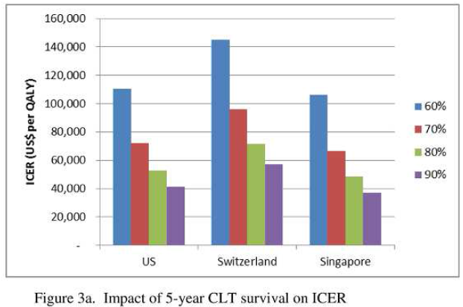
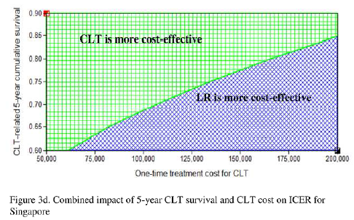
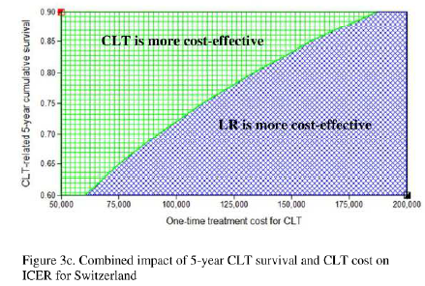
A Markov cohort model
to simulate a cohort of patients aged 55 years with Milan-in HCC and Child-Pugh A/B cirrhosis
undergoing LR or CLT, and followed-up over their remaining life expectancy
In Milan-in, CPT-A/B patients
LR is more cost-effective than CLT
across 3 different costing scenarios
Lim et al, J Hepatol 2014; In press; doi: 10.1002/hep.27135
Notes:
40

Slide 41
INTENTION TO TREAT
TRANSPLANT BENEFIT
Transplant benefit globale
Padova (p trap 64%)
ITA.LI.CA.
Benefit = 11 mesi
p < 0.0001
Il benefit del trapianto si manifesta a 2 anni e a 5 anni giunge al 60% vs il 32 % delle terapie alternative.

Slide 42
INTENTION TO TREAT
TRANSPLANT BENEFIT
Transplant benefit nei pazienti negli stadi BCLC 0 e A
ITA.LI.CA
Padova (p trap 54%)
Benefit = 5 mesi
p = 0,1683
Il benefit proveniente dal trapianto non è significativo per i pazienti allo stadio molto precoce e precoce dell’HCC.

Slide 43
INTENTION TO TREAT
TRANSPLANT BENEFIT
Transplant benefit negli stadi BCLC B e C
Padova (p trap 71%)
Benefit = 14 mesi
ITA.LI.CA
p = 0,023
Il benefit proveniente dal trapianto è significativo per i pazienti negli stadi intermedio
e avanzato, cioè fuori i criteri di Milano (Padova 49% vs ITA.LI.CA.19%).

Slide 44
INTENTION TO TREAT
TRANSPLANT BENEFIT
Transplant benefit nello stadio BCLC D
Padova (p trap 59%)
Benefit = 21 mesi
ITA.LI.CA
p= 0,0054
Il benefit per i pazienti allo stadio terminale è il più significativo – sopravvivenza
a 5 anni del 60% vs 14% delle terapie alternative.

Slide 45
DISCUSSIONE
INTENTION TO TREAT
TRANSPLANT BENEFIT
Transplant benefit e multinodularità
Padova
ITA.LI.CA
p< 0,0001
Il benefit è migliore nei pazienti trapiantati con multinodularità (74% vs 11% a 5 anni).

Slide 46
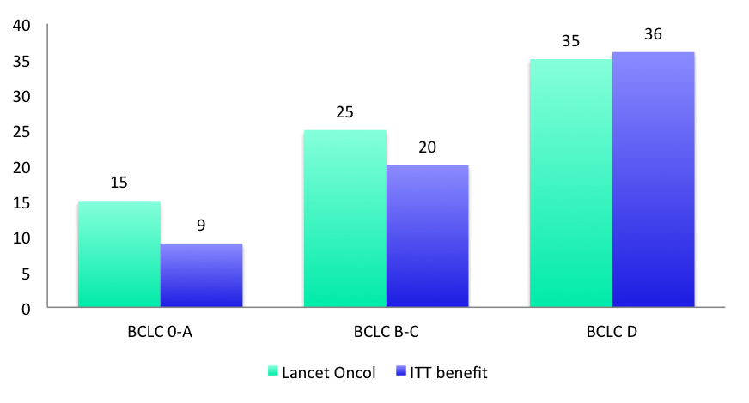
INTENTION TO TREAT
TRANSPLANT BENEFIT
 | PADOVA 5-YR SURV | ITALICA 5-YR SURV | BENEFIT (mesi) | PROB. TRAPIANTO | BENEFIT/ ORGANO (mesi)
BCLC 0-A | 61% | 46% | 5 | 54% | 9
BCLC B-C | 49% | 19% | 14 | 71% | 20
BCLC D | 60% | 14% | 21 | 59% | 36

Slide 47
POPULATION TRANSPLANT BENEFIT
(on 185 Tx at Padova University)IT
Organi
Mesi di vita salvati
BCLC 0-A
BCLC B-C
BCLC D
93
68
24
70
113
72
TOT
185
255 months
BCLC 0-A Utility philosophy (Milan in) 185 139 months
BCLC B-C Benefit philosophy (downstaging) 185 308 months
BCLC D Benefit philosophy (severe cirrhosis+HCC) 185 555 months

Slide 48

PROPOSAL FOR GUIDELINES IMPROVEMENT 3.
Milan In
Due to high benefit consider downstaging in “early B”
Yes
No
Liver Transplantation
(CLT/LDLT)
Consider Resection
Consider Ablation
Consider Liver Transplant
Multidiscipl.
Setting only*
*including Tx specialists and considering organ availability CLT/LDLT
Notes:
48

Slide 49

From an “utility-oriented” to a
“benefit/cost-effectiveness”
oriented point of view
Milan Criteria (TTV, UCSF, UT7 etc)
Single nodule < 5cm
2 or 3 nodules < 3cm
No macroscopic vascular invasion
No extra-hepatic metastases
Notes:
49
49

Slide 50

Decision making for OLTX listing is a
multiparametric, complex and integrated process
based mainly on benefit estimation
BENEFIT
+ + +
UTILITY >50% 5yrs
+
Young age/life expectancy
Notes:
50

Slide 51
Decision making for OLTX listing is a
multiparametric, complex and integrated process
based mainly on benefit estimation
BENEFIT
+ + +
- - -
UTILITY
+
+ + +
UTILITY >50% 5yrs
Young age/life expectancy
P.R. alternative therapies
Notes:
51

Slide 52
Decision making for OLTX listing is a
multiparametric, complex and integrated process
based mainly on benefit estimation
BENEFIT
+ + +
- - -
=
UTILITY
+
+ + +
-
UTILITY >50% 5yrs
Young age/life expectancy
P.R. alternative therapies
Comorbidities
Notes:
52

Slide 53
Decision making for OLTX listing is a
multiparametric, complex and integrated process
based mainly on benefit estimation
BENEFIT
+ + +
- - -
=
+ -
UTILITY
+
+ + +
- -
+ + +
UTILITY >50% 5yrs
Young age/life expectancy
P.R. alternative therapies
Comorbidities
Milan, UCSF, TTV, UT7 in?
Notes:
53

Slide 54
Decision making for OLTX listing is a
multiparametric, complex and integrated process
based mainly on benefit estimation
BENEFIT
+ + +
- - -
=
+ -
+ + +
UTILITY
+
+ + +
- -
+ + +
-
UTILITY >50% 5yrs
Young age/life expectancy
P.R. alternative therapies
Comorbidities
Milan, UCSF, TTV, UT7 in?
Multinodular (< 6 cm)
Notes:
54

Slide 55
Decision making for OLTX listing is a
multiparametric, complex and integrated process
based mainly on benefit estimation
BENEFIT
+ + +
- - -
=
+ -
+ + +
=
UTILITY
+
+ + +
- -
+ + +
-
=
UTILITY >50% 5yrs
Young age/life expectancy
P.R. alternative therapies
Comorbidities
Milan, UCSF, TTV, UT7 in?
Multinodular (< 6 cm)
Low list pressure blood gr.?
Notes:
55

Slide 56
Decision making for OLTX listing is a
multiparametric, complex and integrated process
based mainly on benefit estimation
BENEFIT
+ + +
- - -
=
+ -
+ + +
=
+ + +
UTILITY
+
+ + +
- -
+ + +
-
=
+ +
UTILITY >50% 5yrs
Young age/life expectancy
P.R. alternative therapies
Comorbidities
Milan, UCSF, TTV, UT7 in?
Multinodular (< 6 cm)
Low list pressure blood gr.?
Partial response to DWST?
Notes:
56

Slide 57
Decision making for OLTX listing is a
multiparametric, complex and integrated process
based mainly on benefit estimation
BENEFIT
+ + +
- - -
=
+ -
+ + +
=
+ + +
+ + +
UTILITY
+
+ + +
- -
+ + +
-
=
+ +
+
UTILITY >50% 5yrs
Young age/life expectancy
P.R. alternative therapies
Comorbidities
Milan, UCSF, TTV, UT7 in?
Multinodular (< 6 cm)
Low list pressure blood gr.?
Partial response to DWST?
Out of tx criteria, low αFP?
Notes:
57

Slide 58
Decision making for OLTX listing is a
multiparametric, complex and integrated process
based mainly on benefit estimation
BENEFIT
+ + +
- - -
=
+ -
+ + +
=
+ + +
+ + +
=
UTILITY
+
+ + +
- -
+ + +
-
=
+ +
+
=
UTILITY >50% 5yrs
Young age/life expectancy
P.R. alternative therapies
Comorbidities
Milan, UCSF, TTV, UT7 in?
Multinodular (< 6 cm)
Low list pressure blood gr.?
Partial response to DWST?
Out of tx criteria, low αFP?
LDLT available?
Notes:
58

Slide 59
Decision making for OLTX listing is a
multiparametric, complex and integrated process
based mainly on benefit estimation
BENEFIT
+ + +
- - -
=
+ -
+ + +
=
+ + +
+ + +
=
UTILITY
+
+ + +
- -
+ + +
-
=
+ +
+
=
UTILITY >50% 5yrs
Young age/life expectancy
P.R. alternative therapies
Comorbidities
Milan, UCSF, TTV, UT7 in?
Multinodular (< 6 cm)
Low list pressure blood gr.?
Partial response to DWST?
Out of tx criteria, low αFP?
LDLT available?
HIGH BENEFIT and EXPECTED 5 YR SURVIVAL OF AT LEAST 50%?
CONSIDER OLTX
Notes:
59

Slide 60
Turin 18 October 2012
STATEMENT 5.d
T1 HCC with MELD below 15 should not be listed for liver transplantation unless for well motivated exceptions (E3R1)
Liver transplantation in patients with stage II HCC and Child A cirrhosis results in a low survival benefit
and may not constitute optimal use of scarce liver donor organs
Ioannou G, et al. American Journal of Transplantation 2012; 12: 706–717
Notes:
60

Slide 61

HCC TREATMENT
LIVER
RESECTION

Slide 62
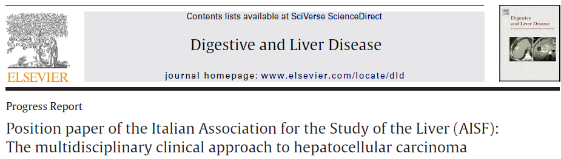
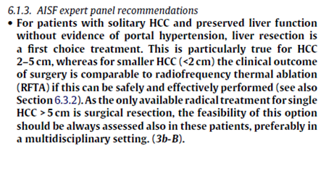
Notes:
62

Slide 63

HCC: Resectability
Tumor
extension
Liver
function
Location
Extension
of hepatectomy for oncolgical radicality
Functional
reserve
Notes:
63
63

Slide 64
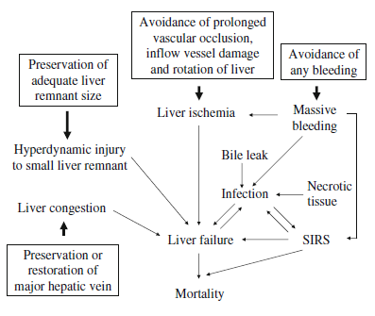
Mechanism of liver failure
after hepatectomy
Fan, J Hepatobiliary Pancreat Sci (2010) 17:380–384
Notes:
64

Slide 65
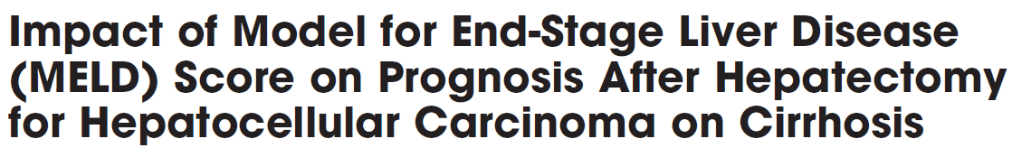
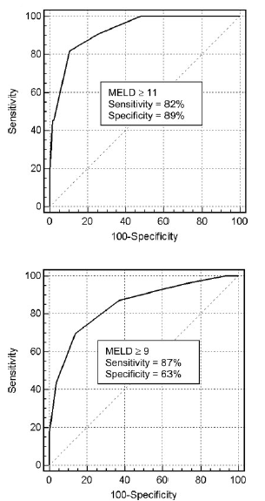
Liver resection & Hepatic Function
Role of MELD score in predeicting
p.o. liver failure and morbidity
after hepatectomy for HCC in cirrhotics
154 HCC-resected cirrhotic patients
11 (7.1%) p.o. liver failure (death or LT)
46 (29.9%) developed ≥ 1 po complication
At ROC analysis:
MELD ≥ 11 High risk for p.o. liver failure
MELD ≥ 9 Major risk for p.o. complications
MELD and
p.o. liver failure
(AUC 0.92
95% CI 0.87-0.96)
MELD and
p.o. complication after hepatic
resection
in cirrhotics
(AUC 0.85,
95% CI 0.78-0.89).
MELD score should be used
to select the best candidates
for hepatectomy
Cucchetti et al, Liver Transplantation 12:966-971, 2006
Notes:
65
65

Slide 66
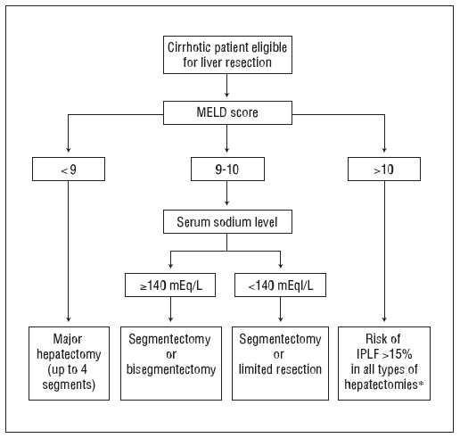
Liver resection & Hepatic Function
Selection of HCC patients for resection is based on
planned extension of hepatectomy and liver functional reserve
http://www.webaisf.org/
Cescon M, et al. Arch Surg 2009
Notes:
66
66

Slide 67

Notes:
67

Slide 68
29 HCC (all except one < 5 cm)
CPT-A
At multivariate analysis
only HVPG was significant
(P = 0.0001; OR 1.90; 95% CI 1.12-3.22).
Preoperative HVPG of decompensated patient was higher (13.9±2.4 vs. 7.4±3.5 mmHg respectively)
P < 0.001
Bruix et al, Gastroenterology 1996 Oct;111(4):1018-22.
Notes:
68

Slide 69
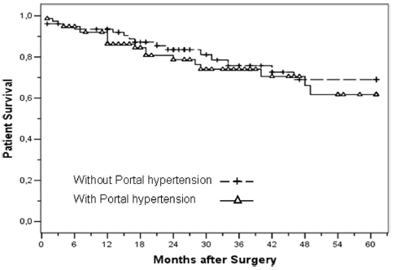
Liver resection & Portal Hypertension
Overall survival curves of resected patients
with and without PH (P =0.453)
241 cirrhotic patients with HCC
89 patients: with portal hypertension (PH)
152 patients without portal hypertension (NPH)
Preoperative mean MELD:
PH → 9.5 ± 7.8
NPH → 8.4 ± 1.3; P 0.001
After one-to-one matching:
PH (n=78) and NPH (n=78) had the same preoperative characteristics and showed the same intraoperative course, postoperative occurrence of liver failure, morbidity, length of in-hospital stay and survival rates (P =ns in all cases).
The only predictors of postoperative liver failure
were MELD score (P 0.001) and extent of hepatectomy (P 0.005)
Faced with the same MELD score
and extent of hepatectomy
Presence of PH should not be considered
as a contraindication
for hepatic resection in cirrhotic patients
Cucchetti et al, Ann Surg 2009;250: 922–928
Notes:
69
69

Slide 70

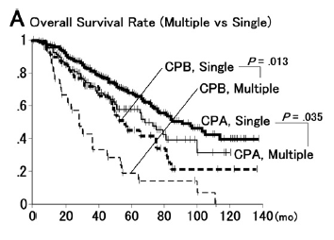
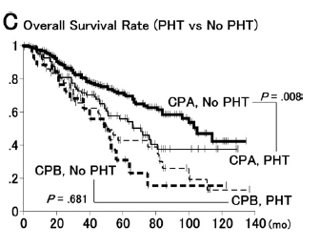
Liver resection & Multifocality
126 Multiple HCC vs
308 single HCC undergoing to resection
Child A patients 5-yr survival
Multiple 58%
Single 68%
Multiple tumors
are not a contraindication
to liver resection
Ishizawa T, et al. Gastroenterology 2008; 134: 1908
Notes:
70

Slide 71


The impact of multinodularity on HCC outcomes: patients with multiple neoplasms
at the time of surgery had a lesser overall survival rate and greater recurrence rate
Hepatic resection can provide long-term survival benefit
in selected BCLC stage B or C patients with compensated liver function
especially in those presenting with a single neoplasm
without vascular invasion
Chang WT, et al. Surgery 2012;152:809-20
Notes:
71
71

Slide 72


SR- Median survival: 11 months
Supportive-care- Median survival : 3.9 months (HR, 0.45; 95% CI, p < 0.001)
Patients who underwent surgical resection had the longest survival
compared to patients undergoing other treatments (33.4 months versus 8.1 months, p < 0.001).
Wang et al, Digestive and Liver Disease 45 (2013) 510– 515
Notes:
72
72

Slide 73



2046 consecutive patients resected for HCC
(10 centers)
  BCLC-0/A: 1012 patients (50%)
  BCLC-B: 737 patients (36%)
  BCLC-C: 297 patients (14%)
BCLC 0-A
BCLC B
BCLC C
Overall Survival (P = 0.000)
 | BCLC 0/A (50%; 1012) | BCLC B (36%; 737) | BCLC C (14%; 297)
1 year | 95% | 88% | 76%
3 years | 80% | 71% | 49%
5 years | 61% | 57% | 38%
Torzilli et al, Ann Surg 2013;257: 929–937
Notes:
73
73

Slide 74

2046 consecutive patients resected for HCC
(10 centers)
  BCLC-0/A: 1012 patients (50%)
  BCLC-B: 737 patients (36%)
  BCLC-C: 297 patients (14%)
Resection is in current practice widely applied
among patients with multinodular, large, and macrovascular invasive HCC
with acceptable short- and long-term results
and justifying an update
of the EASL/AASLD therapeutic guidelines in this sense
BCLC 0-A
BCLC B
BCLC C
Disease Free Survival (P = 0.000)
 | BCLC 0/A (50%; 1012) | BCLC B (36%; 737) | BCLC C (14%; 297)
1 year | 77% | 63% | 46%
3 years | 41% | 38% | 28%
5 years | 21% | 27% | 18%
Torzilli et al, Ann Surg 2013;257: 929–937
Notes:
74
74

Slide 75

Notes:
75

Slide 76
  Tumor Thrombectomy
Several papers on resection of BCLC C tumors
AUTHOR, YEAR | N° OF PATIENTS | Survival
Kumada K, 1990 | 13 | Median: 12months
Wu CC, 2000 | 112 | 5yr: 28%
Minagawa M, 2001 | 18 | 5yr: 42%
Pawlik TM, 2005 | 102 | 5yr: 10% Median: 11months
Le Treut YP, 2006 | 26 | 5yr: 13% Median: 9 months
Ikai I, 2006 | 78 | 3yr: 22% Median: 9 months
Chen XP, 2006 | 286 | 5yr: 18%
Minagawa M, 2007 | 1517 | 5yr: 20-40%
Liang LJ, 2008 | 86 | Median=11months
Inoue Y, 2009 | 49 | 5yr: 40%
Kondo K, 2009 | 48 | 5yr: 30%
Ban D, 2009 | 45 | 5 yr: 21%
In selected cases with tumor thrombus (child A, PST=0, no main trunc) surgery is an INDICATION
(sorafenib as only alternative)

Slide 77

Several papers on resection of BCLC C tumors
Shi J, et al. Ann Surg Oncol 2010; 17: 2073
Notes:
77

Slide 78

Retrospective analysis of HCC_HR database
Between October 1994 and December 2011
in a tertiary care Japanese hospital
pHVTT (also mVI): 153 patients
MHVTT: 21 patients
IVCVTT: 13 patients
Median survival times (MSTs)
pHVTT: 5.27 years
mHVTT: 3.95 years (P=0.77)
Median time to recurrence (TTR):
pHVTT: 1.06 years
mHVTT: 0.41 years (P=0.74)
In IVCTT-group:
MST: 1.39 years
TTR: 0,25 years
furthermore, the MST of Child-Pugh
class B patients was significantly worse (2.39 vs. 0.44 years, P=0.0001). Multivariate
analyses revealed IVCTT (risk ratio [RR] 2.54, P=0.024) and R 1/2 resection (RR 2.08,
P=0.017) as risk factors for the overall survival
Conclusions: Hepatic resection provided acceptable outcomes in HCC patients with mHVTT
or pHVTT when R0 resection was feasible. Resection of HCC may be attempted even in
patients with IVCTT, in the presence of good liver function.
Key words: Hepatocellular carcinoma; Hepatic vein tumor thrombosis; Tumor thrombosis of
the inferior vena cava; Hepatic resection

Slide 79


Type I
Type I
Type II
Type II
Peng ZW, et al. Cancer 2012;118:4725-36
Notes:
79

Slide 80

Retrospective analysis of HCC_HR database
Between October 1994 and December 2011
in a tertiary care Japanese hospital
pHVTT (also mVI): 153 patients
MHVTT: 21 patients
IVCVTT: 13 patients
Median survival times (MSTs)
pHVTT: 5.27 years
mHVTT: 3.95 years (P=0.77)
Median time to recurrence (TTR):
pHVTT: 1.06 years
mHVTT: 0.41 years (P=0.74)
In IVCTT-group:
MST: 1.39 years
TTR: 0,25 years
Kokudo et al, J Hepatol 2014; In press

Slide 81

Retrospective analysis of HCC_HR database
Between October 1994 and December 2011
in a tertiary care Japanese hospital
pHVTT (also mVI): 153 patients
MHVTT: 21 patients
IVCVTT: 13 patients
Median survival times (MSTs)
pHVTT: 5.27 years
mHVTT: 3.95 years (P=0.77)
Median time to recurrence (TTR):
pHVTT: 1.06 years
mHVTT: 0.41 years (P=0.74)
In IVCTT-group:
MST: 1.39 years
TTR: 0,25 years
Kokudo et al, J Hepatol 2014; In press

Slide 82

Retrospective analysis of HCC_HR database
Between October 1994 and December 2011
in a tertiary care Japanese hospital
pHVTT (also mVI): 153 patients
MHVTT: 21 patients
IVCVTT: 13 patients
MST of CPT-B patients
was significantly worse
(2.39 vs. 0.44 years, P=0.0001)
Kokudo et al, J Hepatol 2014; In press

Slide 83

Retrospective analysis of HCC_HR database
Between October 1994 and December 2011
in a tertiary care Japanese hospital
pHVTT (also mVI): 153 patients
MHVTT: 21 patients
IVCVTT: 13 patients
Multivariate analyses revealed
IVCTT (risk ratio [RR] 2.54, P=0.024)
R 1/2 resection (RR 2.08, P=0.017)
as risk factors for the overall survival
Hepatic resection provided acceptable outcomes
in HCC patients with mHVTT or pHVTT
when R0 resection was feasible
Resection of HCC may be attempted even in patients with IVCTT
in the presence of good liver function
Kokudo et al, J Hepatol 2014; In press

Slide 84
Laparoscopy and HCC:
high potential, poor evidence
Laparoscopic approach is an orphan procedure
Bruix J, Sherman. Hepatology 2010
Notes:
84
84
Aggiunto HCC consensus group di Clavien, Lancet Oncology 2012
84

Slide 85


From May 2000 to October 2004
23 Laparoscopic Hepatectomy for HCC
23 Open Hepatectomy for HCC
Selection criteria:
Small (size\5 cm), exophytic, or subcapsular tumor located in the left or peripheral right segments of the liver (II–VI segments, Couinaud)
Well-compensated cirrhosis (Child-Pugh A)
ASA score lower than 3
LH group:
15 subsegmentectomies,
3 segmentectomies,
5 left lateral sectionectomies
OH group:
12 subsegmentectomies
5 segmentectomies
6 left lateral sectionectomies
No statistically significant difference
in mortality and 2-year survival rates between the two groups
Belli G et al, Surg Endosc (2007) 21:2004–2011
Notes:
85

Slide 86

LLR is a safe and effective bridge for patients with small HCC on a waiting list for LT
Laparoscopy offers:
better post operative course
shorter hospital stay
fewer post-operative complications
than the traditional open approach
No statistically significant difference
in mortality and 2-year survival rates between the two groups
Belli G et al, Surg Endosc (2007) 21:2004–2011
Notes:
86

Slide 87

Why Laparoscopic Liver Resection?
Pathophysiological issues
Radicality
Multiple tumors
Large tumors
Portal hypertension
Potential for redo
Location
Multimodal Therapy
Stadiation
Resection
VLS
Ablation
Potential
for redo
Notes:
87

Slide 88
Laparoscopic Liver Resection:
Padova Experience
Hepatobiliary Surgery and Liver Transplant Unit
University of Padova
(Prof. Umberto CILLO)
Complications
Ascites | 2 | 42 (32.6%)
Fever | 2 | 35 (27.1%)
Hemoperitoneum | 3-b | 4 (3.1%)
Pleural effusion | 2 | 4 (3.1%)
Biliary leak | 2 | 3 (2.3%)
Intestinal perforation | 3-b | 2 (1.6%)
Wound infection | 2 | 2 (1.6%)
BPCO | 2 | 1 (0.8%)
Cillo U. unpublished data
Notes:
88
88
88

Slide 89
Laparoscopic Approach
1677 CASES
Courtesy by Luca Aldrighetti

Slide 90

Laparoscopic Liver Resection:
Padova Experience
Hepatobiliary Surgery and Liver Transplant Unit
University of Padova
Chief: Prof. Umberto CILLO
From March 2004 to October 2012
Total hepatic resection | 1113
Total VLS hepatic resection | 129 (11.5%)
converted to “open” | 27 (20.9%)
VLS hepatic resection for HCC | 87 (67.4%)
Cillo U. unpublished data
Notes:
90
90
90

Slide 91

Pathophisiology of LLR
Open liver surgery:
Extremely long incision
Extreme mobilization of the liver
Interruption of the umbelical vein
Interruption ligaments surrounding the liver
Longer post-operative hospital stays
Increased risk of hepatic decompensation and liver failure
In cirrhotic patients:
Significant intraoperative blood loss
Reduced collateral circulation
Development of post-operative intractable ascites
Kanazawa et al, Surg Endosc (2013) 27:2592–2597
Notes:
91
91

Slide 92

Pathophisiology of LLR
Laparoscopic liver surgery:
- Multiple small incisions
- Minimal mobilization of the liver
- Preservation of the paraumbelical vein
- Preservation ligaments surrounding the liver
Shorter post-operative hospital stays
Less risk of hepatic decompensation and liver failure
In cirrhotic patients:
Less intraoperative blood loss
Preservation of collateral circulation
Less post-operative ascites
Kanazawa et al, Surg Endosc (2013) 27:2592–2597
Notes:
92
92

Slide 93


Pathophisiology of LLR
Large Incision
of the abdominal wall
Wide mobilization
of liver
Blockage of the collateral circulation around the liver and abdominal wall
Disturbance of the lymphatic flow
Elevation of post-operative portal vein pressure
Reduction
of sinusoidal bed
Kanazawa et al, Surg Endosc (2013) 27:2592–2597
Notes:
93
93

Slide 94

Pathophisiology of LLR
Kanazawa et al, Surg Endosc (2013) 27:2592–2597
Notes:
94
94

Slide 95


LLR & Radicality
Levels of evidence 2b - 4
Same oncological radicality
MARGINS +
P>0.05
RECURRENCE
P>0.05
Li N et al, Hepatology Research 2012; 42: 51–59
Notes:
95
95

Slide 96
LLR & Multifocality
Laparoscopic surgery can be safely pplied to patients with multiple HCC and the survival outcomes are acceptable
Yoon et al, Surg Endosc (2012) 26:3133–3140
Notes:
96
96

Slide 97

LLR & Large Tumors
245 liver resection (HCC 5-10 cm)
178 open liver resections (Open-Hx)
97 laparoscopic liver resections (Lap-Hx)
No operative deaths
Conversion rate: 9.28%
Ai et al, PLoS ONE 2013, 8(8): e72328
Notes:
97

Slide 98
LLR & Large Tumors
Laparoscopic liver resection is safe and feasible in patients with 5-10 cm HCC
Laparoscopic liver resection can avoid some of the disadvantages of open resection, and is beneficial in selected patients based on preoperative liver function, tumor size and location.
Ai et al, PLoS ONE 2013, 8(8): e72328
Notes:
98

Slide 99

LLR & Morbidity
Levels of evidence 2b - 4
Lower Morbidity and Hospital Stay
MORBIDITY
P<0.01
HOSPITAL STAY
P<0.01
Li N et al, Hepatology Research 2012; 42: 51–59
Notes:
99
99

Slide 100



Lower Overall Complication Rate
The laparoscopic group
showed a lower significant overall complication rate
as compared with the open group
odds ratio 5 .35; CI, .28 –.45; P <0.001; HG: P= 5 .51
Rao et al, The American Journal of Surgery (2012) 204, 222–231
Notes:
100

Slide 101

LLR & Redo Surgery
Recurrence of cancer and the need for several surgical treatments
are the Achilles’ heel of HCC treatment
15 patients submitted to laparoscopic reintervention
(hepatic resection or radiofrequency ablation)
for a recurrence of HCC after a previous OLR o LLR
Overall postoperative mortality : 0%
Overall postoperative morbidity : 26.65
No patients had a severe postoperative complication.
1/15 moderate ascites
1/15 atelectasis requiring physiotherapy
1/15 pneumonia, which was treated with antibiotics.
OLR:
More intra-abdominal adhesions
Longer operative time
Laparoscopic redo surgery
for recurrent HCC in cirrhotic patients
is a safe and feasible procedure
Belli G et al, Surg Endosc (2009) 23:1807–1811
Notes:
101
101
101

Slide 102

LLR & Redo Surgery
Belli G et al, Surg Endosc (2009) 23:1807–1811
Notes:
102
102
102

Slide 103



LLR & Redo Surgery
24 LT:
12 following prior LLR
12 following prior OLR
19/24 Salvage LT
5/24 Neoadjuvant procedure (bridge resection)
Laurent et al, J Hepatobiliary Pancreat Surg (2009) 16:310–314
Notes:
103
103

Slide 104

Initial LLR facilitates subsequent LT
compared with OLR
Median duration of hepatectomy
LLR: 2.5 hours
OLR: 4.5 hours
Median duration of LT:
LLR: 6.2 hours
OLR: 8.3 hours
Reduced operative time
Reduced blood loss
Reduced transfusion requirements
Laurent et al, J Hepatobiliary Pancreat Surg (2009) 16:310–314
Notes:
104
104

Slide 105
LLR & HCC Location
RESECTION SCORE (MODEL 3):
MULTIVARIATE LOGISTIC REGRESSION
PRIMARY ENDPOINT: Irreversible postoperative liver failure
(IPLF = death or LT due to liver decompensation within 6 months)
Term | Estimate | Prob>ChiSq | Odds Ratio | Odds Lower | Odds Upper
Na+ | 0,00464511 | 0,9515 | 1,08720691 | 0,07104124 | 16,1211385
CHILD CLASS B | 0,91580756 | 0,1082 | 2,49879237 | 0,80341117 | 7,6530879
CRPH | 0,2333859 | 0,6041 | 1,26286872 | 0,51683322 | 3,05707899
Other vs anterior | 1,33630565 | 0,0116 | 3,80496065 | 1,41314079 | 11,5284757
MELD 9-10 vs MELD < 9 | 2,09126842 | 0,0024 | 8,09517673 | 2,36047288 | 38,0609384
MELD >10 vs MELD 9-10 | 0,3524321 | 0,4723 | 1,42252307 | 0,54146334 | 3,75950044
AFP 100-1000 vs <100 | 0,96305372 | 0,0710 | 2,61968405 | 0,89160956 | 7,38705937
AFP >1000 vs 100-1000 | 1,02449174 | 0,1197 | 2,78567925 | 0,77309904 | 10,4497543
TUMOR VARIABLE | 1,13023251 | 0,0139 | 3,09637636 | 1,27598406 | 7,84986423
TUMOR VARIABLE = largest diameter (cm) + nodule number index* (1 for single, 2 for 2-3 nodules, 5 for > 3 nodules)
CRPH = clinically relevant portal hypertension
*Nodule number index is thought to overcome problems of preoperative imaging in staging coorectly number of nodules
U. Cillo, Unpublished data
Notes:
105

Slide 106
LLR & HCC Location
RESECTION SCORE (MODEL 3):
MULTIVARIATE LOGISTIC REGRESSION
A resection score > 5 means high risk of IPLF (> 10%)
LOCATION | Anterior Other | 0 2
AFP | ≤100 100-1000 >1000 | 0 2 3
TUMOR VARIABLE > 7 | No Yes | 0 2
MELD | <9 9-10 >10 | 0 3 4
U. Cillo, Unpublished data
Notes:
106

Slide 107
LLR & HCC Location
RESECTION SCORE (MODEL 3):
MULTIVARIATE LOGISTIC REGRESSION
Area Under Curve = 0.82917
U. Cillo, Unpublished data
Notes:
107

Slide 108
Resection Score (model 3):
Impact of Long Term survival
BCLC A patients (n=280)
BCLC B-C patients (n=119)
P=0.0040
P=0.0010
Resection score ≤ 5 (n=218)
Median survival = 67 months
Resection score ≤ 5 (n=82)
Median survival = 42 months
Resection score > 5 (n=62)
Median survival = 34 months
Resection score > 5 (n=37)
Median survival = 10 months
U. Cillo, Unpublished data
Notes:
108

Slide 109

LLR & Multimodal Therapy
Hepatic resection combined
with intraoperative local ablation therapy
is effective for multinodular HCCs
Lin CT et al. World J Surg 2010; 34: 2155
Notes:
109

Slide 110

Notes:
110
110

Slide 111

Laparoscopic approach advantages:
ABLATION
Difficult locations
(superficial lesions; near to GI tract, galbladder, biliary tract; cholecistectomy possible)
Higher aggressiveness
(general anesthesia, decrease in portal
flow due to pneumoper. and stop-flow increase ablationvolume )
Possibility to treat decompensated cirrhosis
(ascites, hemostasis, no interruption
collateral vessels)
Notes:
111
111
111

Slide 112
Laparoscopic approach series:
ABLATION
 |  | N° pz | Morbidity (%) | Mortality (%) | Survival – 1yr (%) | Survival -3yr (%)
RF | Karabulut, 2011 | 92 |  | 1.2 |  | 40
 | Simo, 2011 | 22 | 40 | 0
 | Asahina, 2009 | 84 |  |  | 100 | 84
 | Santambrogio, 2009 | 74 | 16 |  | 88 | 66
 | Eisele, 2008 | 15 |  | 0
 | Ballem, 2008 | 104 |  |  |  | 21
 | Buell, 2008 | 155 | 13 | 2.1
 | Berber, 2007 | 131 | 5 | 1.83 | 86 | 43
 | Padova (2010) | 169 | 26 | 0 | 78 | 40
MW | Hsieh, 2004 | 40 | 35 | 2.5 | 78
 | Seki, 2005 | 68 |  |  | 97
 | Kawamoto, 2005 | 69 | 100 | 0 |  | 80
 | Simo, 2011 | 13 | 45 | 0
Levels of evidence
2b - 4

Slide 113
INDICATION FOR LAPAROSCOPIC RFA: PATIENT AND TUMOR FACTOR
INDICATION FOR RFA (one of the following criteria):
CHILD-B patient
CHILD-A patients with a liver function that made a postoperative hepatic decompensation likely
thrombocyte count <100,000/μl
signs of portal hypertension on imaging
MELD score>10
The extension of the necessary resection made a post-operative liver failure likely
More than one resection necessary to clear all HCC nodules
SIZE AND NUMBER OF THE HCC:
The largest HCC < 3.5 cm in diameter
The number of HCC nodules ≤ 3
Herbold T et al, Langenbecks Arch Surg 2012
Notes:
113
113

Slide 114
INDICATION FOR LAPAROSCOPIC VS. PERCUTANEOUS RFA
INDICATION FOR RFA:
Localization of the HCC within 1 cm of the liver capsule
Localization in the dome of the liver (difficult needle placement in axial plane)
Size of the nodule> 2.5 cm
Bridge to transplantation as therapeutic aim of RFA
Herbold T et al, Langenbecks Arch Surg 2012
Notes:
114
114

Slide 115


Upstaging of the tumor stage by IOUS: 32 % of the patients
Overall Survival: 44.7 ± 6.9 months
Intrahepatic recurrence rate: 61.8 %
Laparoscopic RFA is a feasible and reliable therapy for unresectable HCCs especially in patients with cirrhosis when a surgical resection is not possible.
→ EFFECTIVE LOCAL CONTROL OF THE DISEASE
→ LOW RATE OF COMPLICATIONS
In comparison to percutaneous access:
→ Easier localization of the nodule within the liver
→ Increase in the size of the ablation zone
Laparoscopic RFA can provide significant survival for patients with HCC
while also forming a bridge to liver transplantation
LT
NO LT
Overall patient survival after treatment of HCC by laparoscopic RFA
Mean survival 44.7 ± 6.9 months
(95%CI, 31.2–58.1 months)
Overall patient survival after treatment of HCC by laparoscopic RFA
influence of liver transplantation
Mean survival
LT: 70.5 ± 10.9 months (95%CI, 49.2–91.7 months)
NO-LT: 22.8±4.3 months (95%CI, 14.5– 31.2 months)
Herbold T et al, Langenbecks Arch Surg 2012
Notes:
115
115

Slide 116

HCC treatment by
Laparoscopic RFA
From Herbold T et al, Langenbecks Arch Surg 2012
Notes:
116
116

Slide 117


Prospective
January 2004 → December 2009
169 consecutive HCC patients
ineligible for HR and/or percutaneous ablation
72% with clinically relevant portal hypertension
50% multinodular tumors or nodules < 25 mm
61% RFA ablation
5% MWA ablatiion
34% ethanol injection
No perioperative mortality
Overall morbidity rate: 25%
Median postoperative hospital stay: 3 days
Median survival: 33 months
3-year survival: 47%
preoperative
predictors
of survival
Laparoscopic ablation
is a safe and effective therapeutic option
for selected HCC patients
ineligible for liver resection
and/or percutaneous ablation
post-operative
predictors
of survival
Cillo et al, PloS ONE 2013; (2):e2013;857249
Notes:
117

Slide 118
Lap-MWA versus Lap-RFA
35 HCC-patient; Laparoscopic MWA or RFA
22/35: Lap-RFA (27 tumors)
13/35: Lap-MWA (15 tumors)
Average ablation volumes:
Lap-RFA: 23.43 cm3
Lap-MWA: 28.99 cm3, (=0.69)
Average operative times:
Lap-RFA: 149 ± 35 minutes
Lap-MWA: 112 ± 40 minutes (P=0.004)
Mean follow-up Lap-RFA: 19 months
50% alive without evidence of disease
9% alive with disease
36% deceased
5% lost to follow-up.
Mean follow-up Lap-MWA: 7 months
54% alive without evidence of disease
31% alive with disease
15% deceased
Simo T et al, Journal of Surgical Oncology 2011;104:822–829
Notes:
118
118

Slide 119

LT after laparoscopic-assisted Ablation
Microwave technology is as efficacious and safe as RFA
in the laparoscopic-assisted ablation of HCC in cirrhotics
Shorter operative times
Complete coagulative
Need for prospective RCT
Simo T et al, Journal of Surgical Oncology 2011;104:822–829
Notes:
119
119

Slide 120



Prospective study
From December 2009 → December 2010
42 HCC considered unelegible for liver resection and/or percutaneous ablation
47 of 50 nodules (94%) treated with Laparoscopic MWA
obtained a CR at 3 months evaluation
No perioperative mortality
Overall morbidity rate: 24%
2-yr survival: 79%
2-yr recurrence rate: 55%
Laparoscopic MWA is safe and effective therapeutic option for slected HCC patients ineligible for liver resection and/or percutaneous ablation
Survival
Recurrence
Cillo et al, HPB 2014, In press
Notes:
120
120

Slide 121





Improvement in Surgical
outcome reflects...Centre Volume
REFERRAL PRECOCE
AI CENTRI DI ALTA SPECIALITA’
Glasgow et al, Arch Surg 1999; 134: 30-35
Yasunaga- Hepatology Research 2012; 42: 1073–1080
Notes:
121

Slide 123



But...
...is HIV-therapy virtual?
The 90% unmet need for HIV treatment
makes remnant therapeutic successes virtual?
Notes:
123

